Slide 1
AI to optimize agricultural breeding
Progress recording – A bite of Sugarcane Genomic prediction
July – Nov 2021

Slide 2

INDEX
Overview
Models & Environment & Dataset
2. Results
3. Conclusion & Discuss
Notes:
Guidelines for use:
Use this slide when presenting at UQ or at any site in Australia, when appropriate.
Remember to pause briefly after acknowledging Country as a sign of respect.
If you are more familiar with acknowledging Country you may add a statement about the event, meeting or forum’s connection with Country. For example; at a higher education event you might acknowledge that the campus has always been a space for teaching, learning, research and collaboration tens of thousands of years before it was established as a university campus, and continues today.
When to use longer version:
If you are the main speaker at the event/gathering
If you are the first person to present.
When to use a shorter version:
If you are not the first person to acknowledge Country
In a more informal setting
Thanking a Traditional Owner for welcoming people to Country.
Longer version
I acknowledge the Traditional Owners and their custodianship of the lands on which we meet today. (On behalf of *) I pay our respects to their Ancestors and their descendants, who continue cultural and spiritual connections to Country. We recognise their valuable contributions to Australian and global society.
* If you are hosting an event, meeting or seminar, you might say something like “On behalf of the event organisers or your section….”
Shorter version
I (too,) acknowledge the Traditional Owners and their custodianship of the lands on which we meet today and pay my respect to their Ancestors and their descendants.
Slide last updated June 2019 – content owner is PVC(IE)/ATSISU (contact Nell Angus).

Slide 3
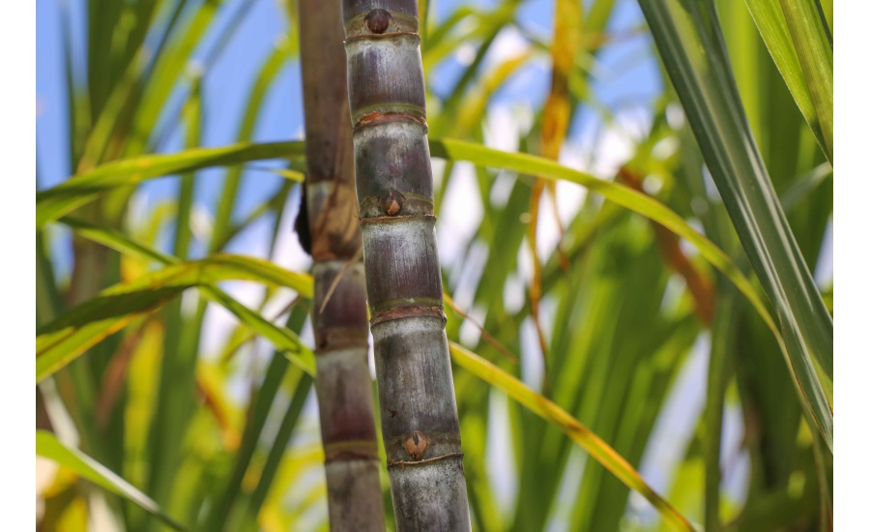
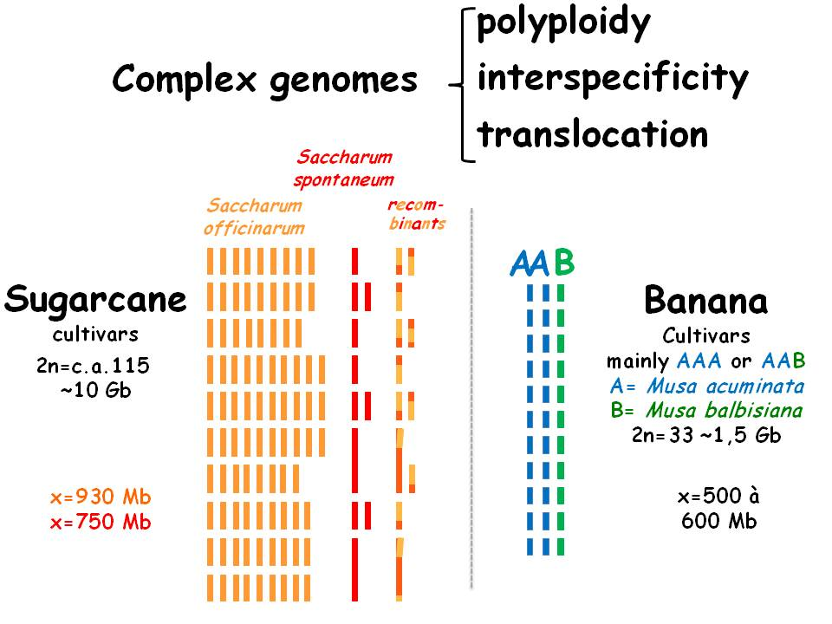
Sugarcane
Genetic Prediction in Sugarcane Genome:
Selected Traits:
Tons of sugarcane per hectare (TCH) ☆
Commercial cane sugar (CCS)
Fibre content – Fibre
Slowly genetic progress because of the complex genome
highly heterozygous and highly polyploid;
Also associated by --
Non-additive genetic effects.
Pic resource: https://umr-agap.cirad.fr/en/research/scientific-teams/structure-and-evolution-of-genomes/context-and-challenges

Slide 4
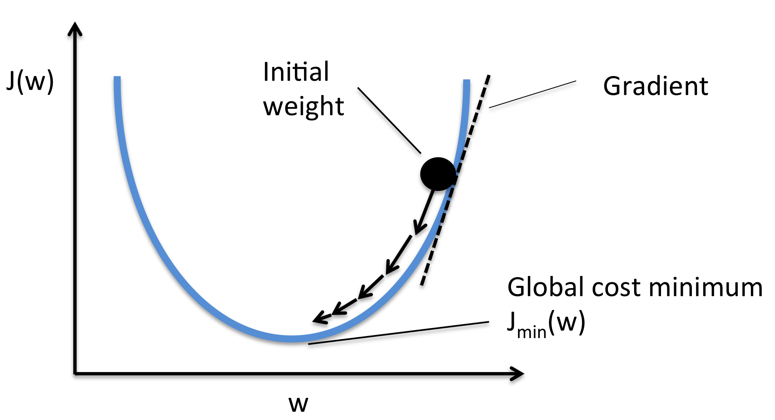
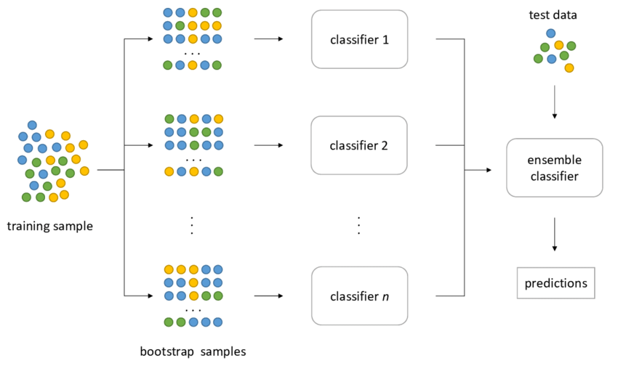
Machine Learning
Gradient descent Classifier ensemble
Upgrading neural units
Bootstrap aggregating
http://rasbt.github.io/mlxtend/user_guide/general_concepts/gradient-optimization/
https://hudsonthames.org/bagging-in-financial-machine-learning-sequential-bootstrapping-python/

Slide 5
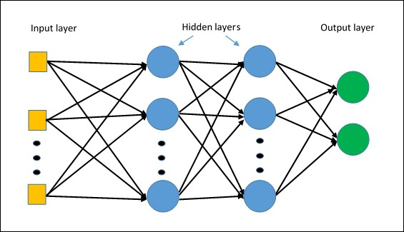
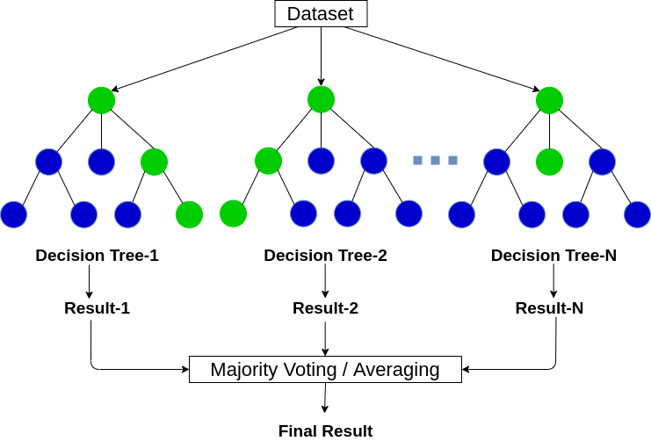
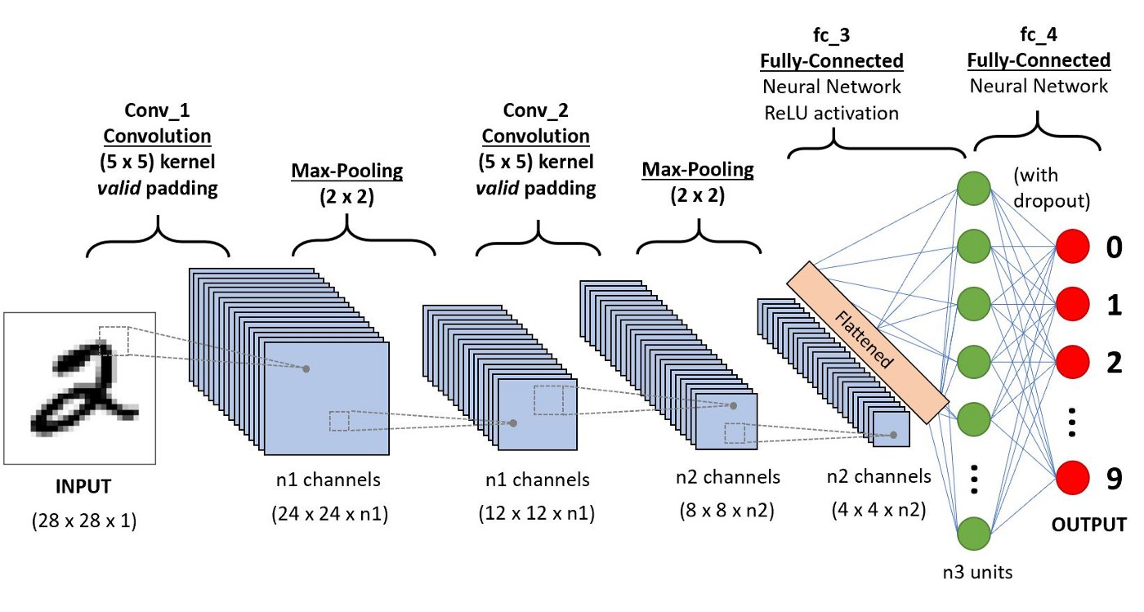
Models
Fully connected layer
Neural Network
Random Forest
Multilayer Perceptron (MLP)
Convolutional neural network (CNN)
partial features
Weight & Bias & Act Function
Convolutional layer

Slide 6
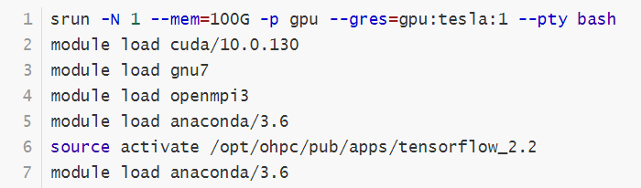
Environment & Dataset
Environment (On Wiener HPC)
Python Packages:
Neural Network: Keras/TensorFlow
Random Forest: scikit-learn
Dataset:
Train Set: 2013-2015
Valid Set: 2017
Sugarcane Resource: Australian and Brazilian germplasm from 2013-2017
Totally 2909 clones;
25753 high-quality SNPs;
Other non-genetic factors;
3 quantitative traits.
Series | Region | Trial | Crop | Clone | CCSBlup | TCHBlup | FibreBlup | I | II | III | IV | V
2013 | N | BAB13-33 | 1R | MQ239 | -0.5802 | 16.5619 | 4.0233 | AA | TT | AT | AT | TT
One Clone might have multiple records

Slide 7
Data Transformation
OneHotEncoder Function:
Transform GENOTYPE markers to 4 binary channels. (The 4th channel is for missed data)
e.g.
 | I | II | III | IV | V
MQ239 | AA | TT | AT | AT | TT
Q250 | AT | AA | TT | AT | -
QN07-1046 | AT | AA | TT | AT | AA
 | Channel | I | II | III | IV | V
MQ239 | AA | 1 | 0 | 0 | 0 | 0
 | AT | 0 | 0 | 1 | 1 | 0
 | TT | 0 | 1 | 0 | 0 | 1
 | -- | 0 | 0 | 0 | 0 | 0
Q250 | AA | 0 | 1 | 0 | 0 | 0
 | AT | 1 | 0 | 0 | 1 | 0
 | TT | 0 | 0 | 1 | 0 | 0
 | -- | 0 | 0 | 0 | 0 | 1
QN07-1046 | AA | 0 | 1 | 0 | 0 | 1
 | AT | 1 | 0 | 0 | 1 | 0
 | TT | 0 | 0 | 1 | 0 | 0
 | -- | 0 | 0 | 0 | 0 | 0

Slide 8
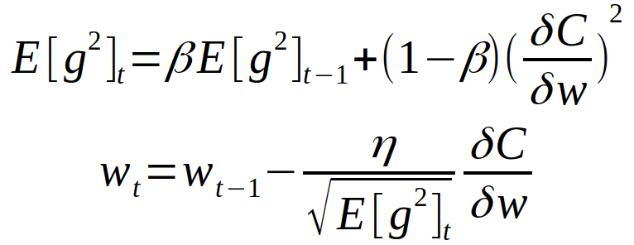
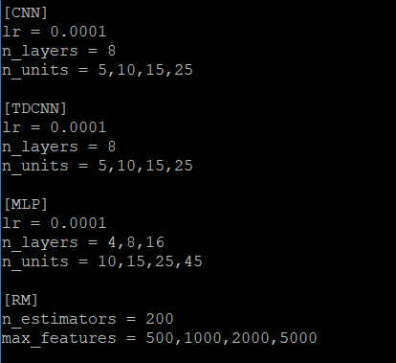
Hyper-Parameter Selection
Hypothesis:
Editing hyper-parameters in CNN/MLP/RF could help predicting traits.
NN Optimizers: RMSProp (Root Mean Square Prop)
Metrics: Mean Squared Error & Pearson’s correlation
50 Epochs / per NN model ~ round
10 Round for estimating mean performance
Convolutional layer:
1st Conv layer: 64 filters, 5 kernel size, 3x1 step
Maxpooling layer (2x1 pooling size)
2nd Conv layer: 128 filters, 3 kernel size, 3x1 step
Maxpooling layer (2x1 pooling size)
Dropout Rate 0.2
n_layers in the MLP
n_units in each MLP layers
Number of trees in Random Forest

Slide 9
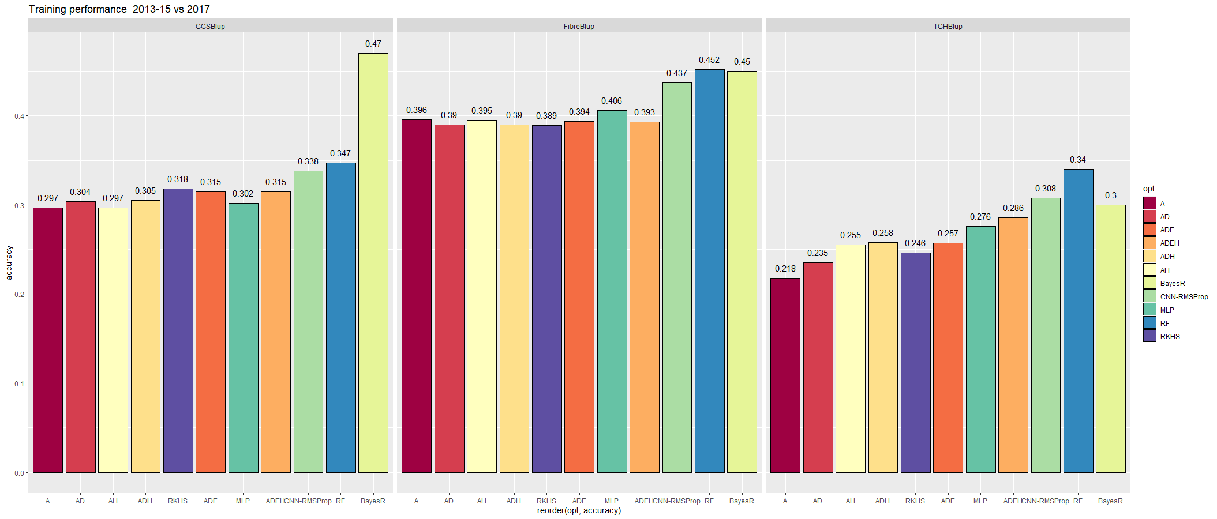
Comparison within methods
MLP parameters: n_layers = 5, n_units = 8; RF n_features:2000
GBLUP
Yadav, S., Wei, X., Joyce, P. et al. Improved genomic prediction of clonal performance in sugarcane by exploiting non-additive genetic effects. Theor Appl Genet 134, 2235–2252 (2021). https://doi.org/10.1007/s00122-021-03822-1
Hayes, B.J., Wei, X., Joyce, P. et al. Accuracy of genomic prediction of complex traits in sugarcane. Theor Appl Genet 134, 1455–1462 (2021). https://doi.org/10.1007/s00122-021-03782-6

Slide 10
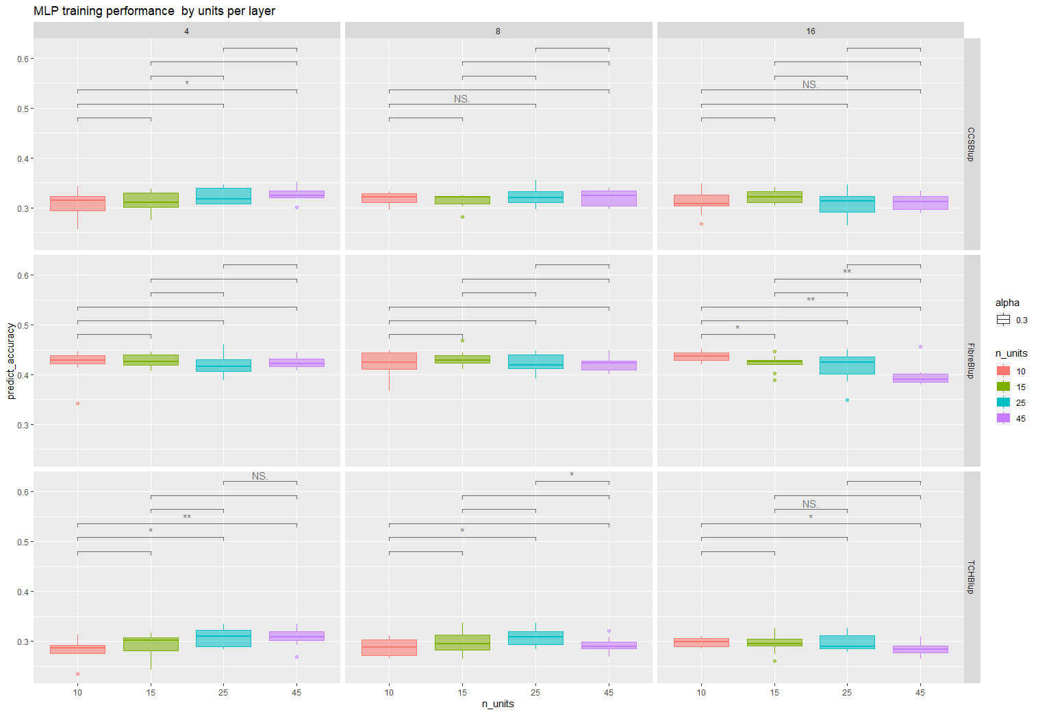
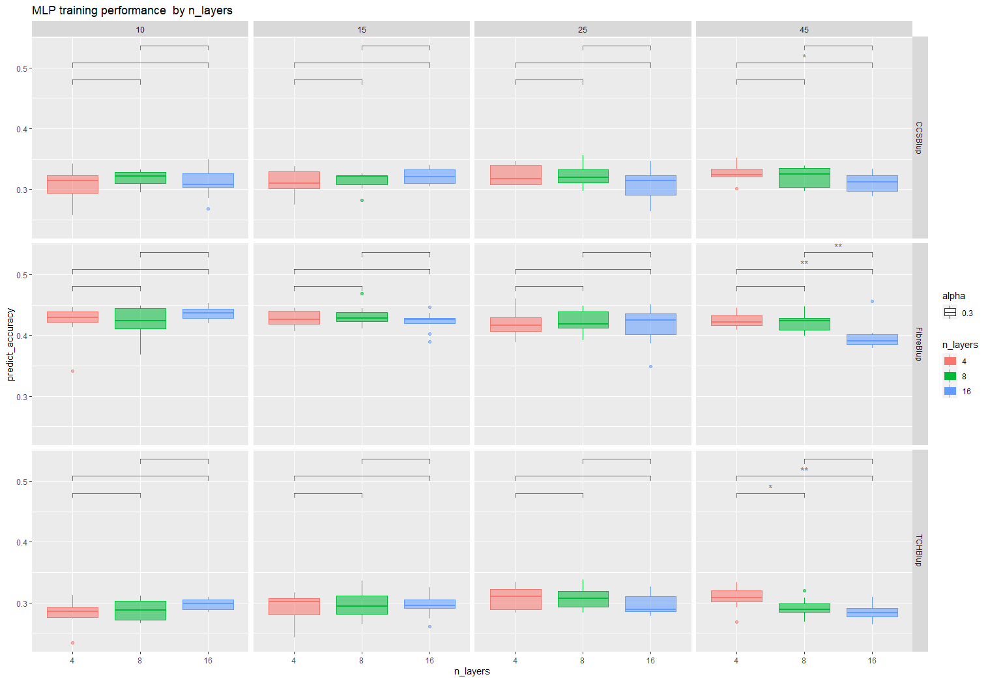
MLP Performance
Performance of Units
Performance of Layers：

Slide 11
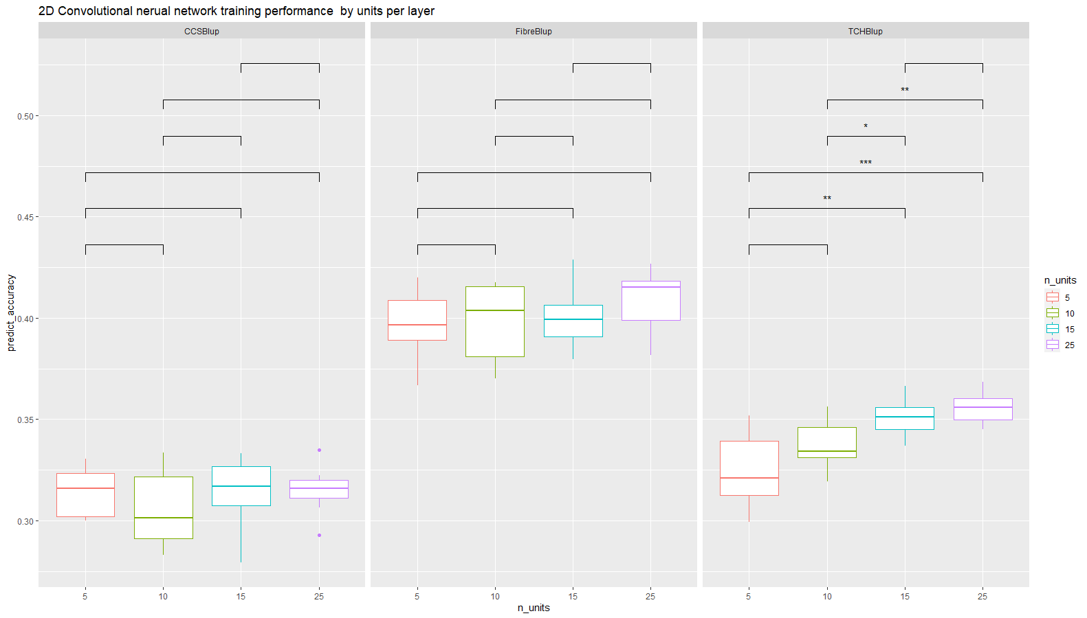
CNN Performance

Slide 12
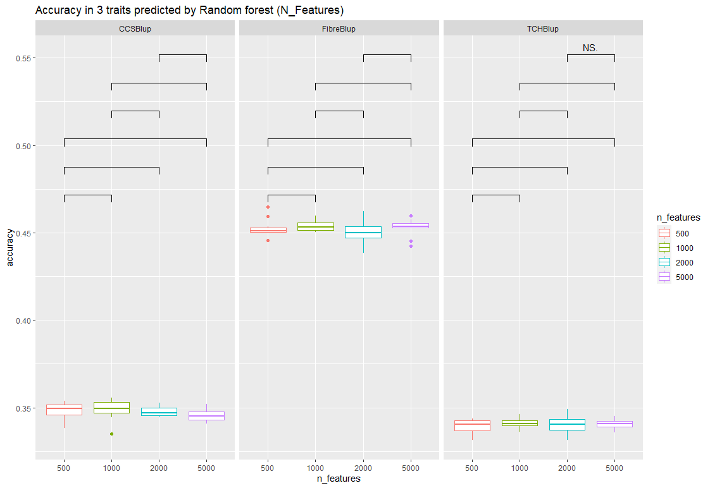
Random Forest Performance

Slide 13
Conclusions
CNN has superiorities in TCH prediction.
Increase of features (RF) didn’t brings major effects in TCH prediction
Increase of MLP layers plays negative effects in TCH prediction
Above hyper-parameter shows minor effects in other trait prediction

Slide 14



Thank you
Chensong Chen | 1st year PhD student
Queensland Alliance for Agriculture and Food Innovation
uqcche32@uq.edu.au
07 0000 000
@QAAFI
facebook.com/QAAFIatUQ
linkedin.com/company/QAAFI

